Slide 1
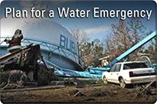
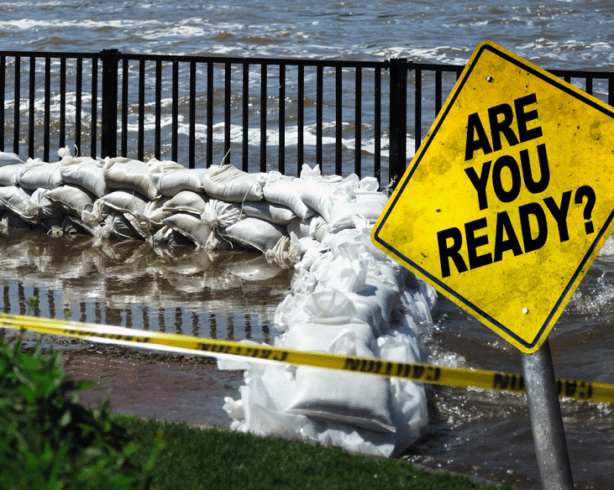
Susquehanna River Basin Commission
Public Water Supply Assistance Program
Preparing Your Water System: Emergency Preparedness and Resiliency
Patti Kay Wisniewski, US EPA Region 3
October 18, 2018
Harrisburg, PA
Notes:
All tools have links in the Notes.

Slide 4
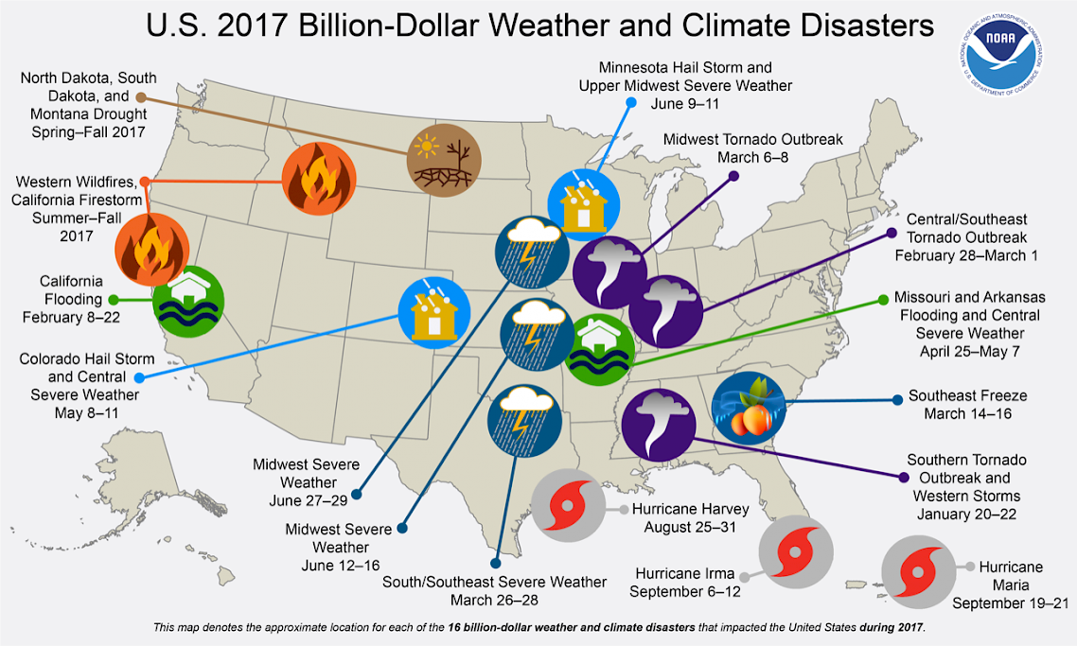
Notes:
Fourteen Named Storms Predicted for "Slightly Above Average" 2018 Atlantic Hurricane Season
The Colorado State University’s (CSU’s) Tropical Meteorology Project has just released its “Extended Range Forecast of Atlantic Seasonal Hurricane Activity and Landfall Strike Probability for 2018.” As noted in the report, the researchers anticipate slightly above-average activity for the upcoming season, which runs from June 1 to November 30. The researchers also predict there will be 14 named storms – those reaching the criteria for hurricanes, tropical storms, or sub-tropical storms are named – and that there is a 63% chance of a major hurricane making landfall somewhere on the entire U.S. coastline.

Slide 5
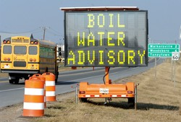
All Hazards Resiliency
Adapting to climate change
Security – physical and cyber
Preparedness / Response
Safety
Algal Blooms
Business Continuity (COOP)
Sustainability
Pandemic Flu Planning
Notes:
Remember Y2K?

Slide 6
Wake-Up Calls?
Catalog of impacts to water systems, e.g.
Freedom Chemical - Charleston, WV
Duke Energy coal ash – Dan River intakes, VA
Walkersville, MD - sewage & manure
Colonial pipeline oil spill – Fairfax Water, VA
Derecho, TS Lee, Superstorm Sandy – damage & power outages
Others, and near misses

Slide 7
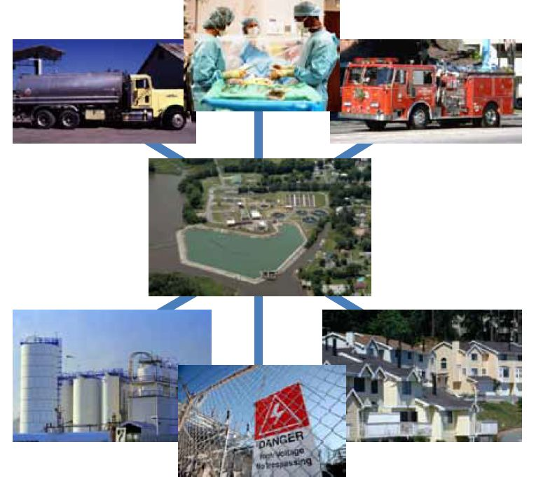
Water Sector Interdependencies
The following community services share interdependencies with the water sector:
Emergency services
Healthcare facilities
Schools
Transportation
Energy Production
Postal and shipping services
Telecommunications
Food and beverage production and preparation
Notes:
The following community services share interdependencies with the water sector and may be negatively affected in the event that drinking water and/or wastewater services are not available:
Emergency services
Healthcare facilities
Schools
Transportation
Energy Production
Postal and shipping services
Telecommunications
Food and beverage production and preparation
Ask participants if they have examples of additional interdependencies.

Slide 8
Past Disaster Response Lessons Learned
Utility operations are specialized;
Utilities must be self-sufficient;
All emergencies are local at the start;
Utilities must fill the gap between disaster onset and arrival of government aid;
FEMA is muscular but not agile;
Water restoration brings hope!

Slide 9
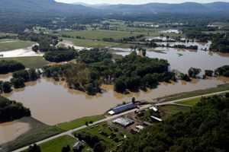
Resilience
The term "resilience" refers to the ability to adapt to changing conditions and withstand and rapidly recover from disruption due to emergencies.
March 30, 2011
PRESIDENTIAL POLICY DIRECTIVE/PPD-8
SUBJECT: National Preparedness

Slide 12
Notes:
.ALL CHECKLISTS CAN BE FOUND AT: https://www.epa.gov/waterutilityresponse/incident-action-checklists-water-utilities
These exist for the following types of incidents.
• Harmful Algal Bloom Incident Action Checklist (PDF)(8 pp, 1 MB)
• Cybersecurity Incident Action Checklist (PDF)(6 pp, 2 MB)
• Extreme Cold and Winter Storms Incident Action Checklist (PDF)(8 pp, 1 MB)
• Earthquake Incident Action Checklist (PDF)(8 pp, 1 MB)
• Drought Incident Action Checklist (PDF)(8 pp, 2 MB)
• Extreme Heat Incident Action Checklist (PDF)(7 pp, 835 K)
• Flooding Incident Action Checklist (PDF)(9 pp, 2 MB)
• Hurricane Incident Action Checklist (PDF)(8 pp, 2 MB)
• Tornado Incident Action Checklist (PDF)(8 pp, 1 MB)
• Tsunami Incident Action Checklist (PDF)(8 pp, 1 MB)
• Volcanic Activity Incident Action Checklist (PDF)(10 pp, 2 MB)
• Wildfire Incident Action Checklist (PDF)(8 pp, 986 K)

Slide 13
Notes:
ERP guidance is under review and development of a more useful tool is expected in late 2018.
https://www.epa.gov/sites/production/files/2015-04/documents/2004_04_27_watersecurity_pubs_small_medium_erp_guidance040704.pdf

Slide 14
Black Sky Events
Notes:
All Guides are available here: https://www.epa.gov/waterutilityresponse
POWER: https://www.epa.gov/sites/production/files/2016-03/documents/160212-powerresilienceguide508.pdf
EARTHQUAKE GUIDE: https://www.epa.gov/sites/production/files/2018-02/documents/180112-earthquakeresilienceguide.pdf
Black Sky events are long duration (one month or more), regional power outages; these can be caused by severe weather and earth quakes or by electromagnetic pulses (EMP), severe space weather or cyber and physical attacks.

Slide 15
Notes:
https://www.epa.gov/waterutilityresponse/flood-resilience-basic-guide-water-and-wastewater-utilities

Slide 16
Notes:
https://www.epa.gov/waterutilityresponse/drought-response-and-recovery-water-utilities

Slide 17
Notes:
https://www.epa.gov/waterutilityresponse/hazard-mitigation-natural-disasters

Slide 19
WARNS
Network of utilities helping utilities,
Not a corporation or governmental unit
Aid each other with personnel and resources

Slide 20
Questions
Are you on my email group?
If not, give me a card or send me your info
Patti Kay Wisniewski
215-814-5668
Wisniewski.patti-kay@epa.gov
EPA webpage has a Contact Us link to reach any staff
Notes:
Desk phone rings to cell at all times!
Drinking Water Branch Chief is Karen (Karrie) Crumlish

